Slide 1
Cribbage Player AI
Kayla Henneman, Apeksha Barhanpur, Swaraj Wankhade

Slide 2
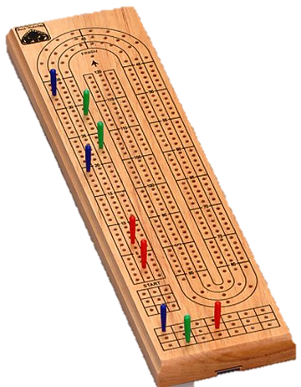
Background
What is Cribbage?
Card game, usually played with two
players
Can be played with 3 or 4
Win by getting at least 121 points
Played with a Cribbage board
Players keep track of points
with pegs on board
Winner: First player to get 121 points

Slide 3
How to Play
In each round, players are dealt 6 cards each
Players gain points by:
Fifteens (2 points each)
Runs (1 point for each card in the run)
Pairs (2 points each)

Slide 4
Round Breakdown
One round consists of four stages
STAGE 1: Each player discards 2 cards into the crib
STAGE 2: Players take turns laying down cards (can peg points)
STAGE 3: Each player counts the number of points in hand (non-dealer first) with the addition of one random card
Random card flipped after discards are made
Both players use same random card
STAGE 4: Dealer counts the crib, made of discarded cards
Dealer alternates in each round

Slide 5
Example Hand
Hand: [6, ♥] [6, ♦] [7, ♦] [8, ♠] [J, ♠] [J, ♦]
Discard: [J, ♠] [J, ♦]
Random card: [9, ♠]
Total points in hand: 16
Total points known in crib: 2
Round score
Player’s crib: 18
Opponent’s crib: 14

Slide 6
Problem Description
Implement a Cribbage Player AI which makes intelligent discard decisions
Maximize round score
Calculating round score
Player’s crib:
Round score = hand score + crib score
Opponent’s crib:
Round score = hand score – crib score

Slide 7
Rules and Assumptions
Ignore stage two of a round
Points are gained as follows:
Two points for each fifteen
One point for each card in the run
3-card run = 3 pts
4-card run = 4 pts
Two points for each pair
Score of round determined as shown on Slide 6
Winner will be the first player to 121 points

Slide 8
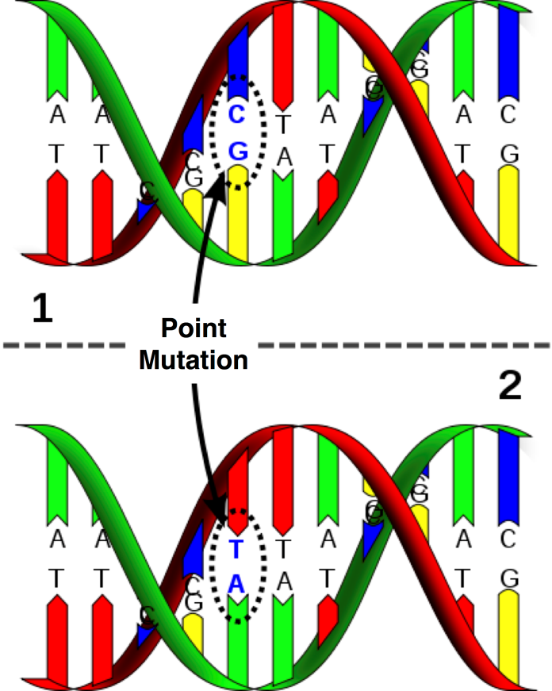
Methods
Training Algorithm:
Evolutionary Strategy
Similar to Genetic Algorithms
Use only mutation

Slide 9
Evolutionary Strategy
Create population of n hands
While training, ignore suit
Possible hands: 18,395
Otherwise: 20,358,520 possible hands
Assign each card in each hand a value, v
0.1 ≤ v ≤ 0.9
Train each hand m times (n * m iterations)

Slide 10
Training a Hand
Choose the two cards associated with smallest values to discard
If discard is successful, keep these values
If discard is unsuccessful, replace these two values with new values
Choose new values at random
A successful discard is one whose score is not less than 75% of the optimal score possible with this hand

Slide 11
Example Training
Hand | 2 | 5 | 5 | 5 | 6 | K
Values | 0.78 | 0.79 | 0.88 | 0.76 | 0.66 | 0.33
Discard K, 6
No points go to crib
Optimal Score: 14
Score: 8
Unsuccessful (8 < 0.75 * 14)
Replace 0.66 and 0.33 with two new random values

Slide 12
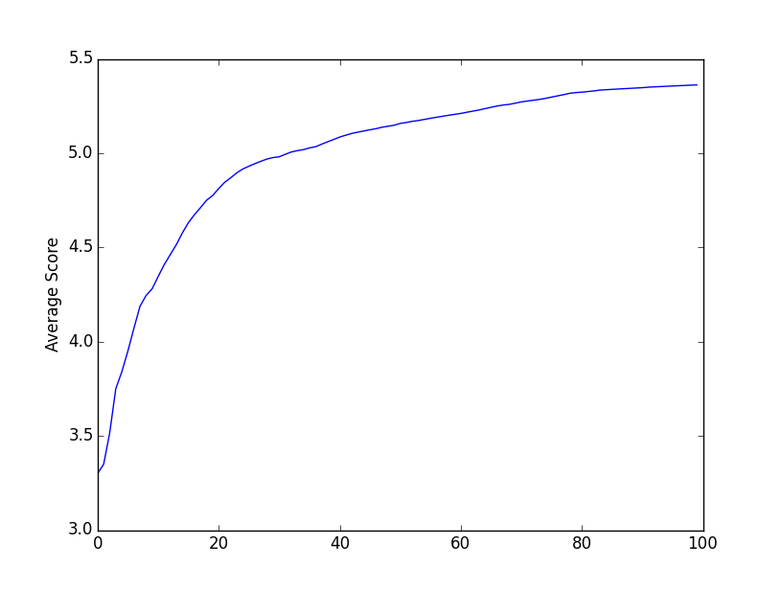
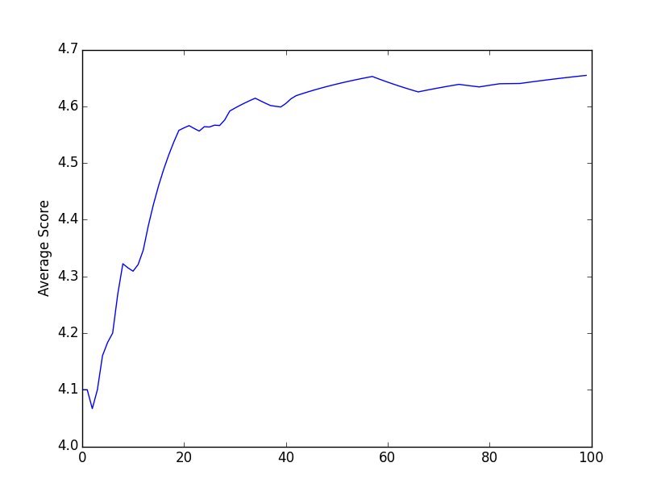
Training Results
Computer’s Crib
20 hands, 100 times
Opponents Crib
Optimal Average: 7.10
Optimal Average: 6.25

Slide 13
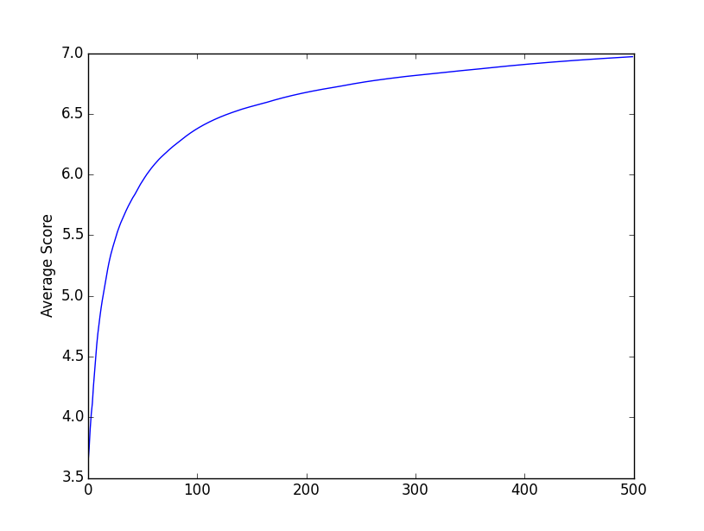
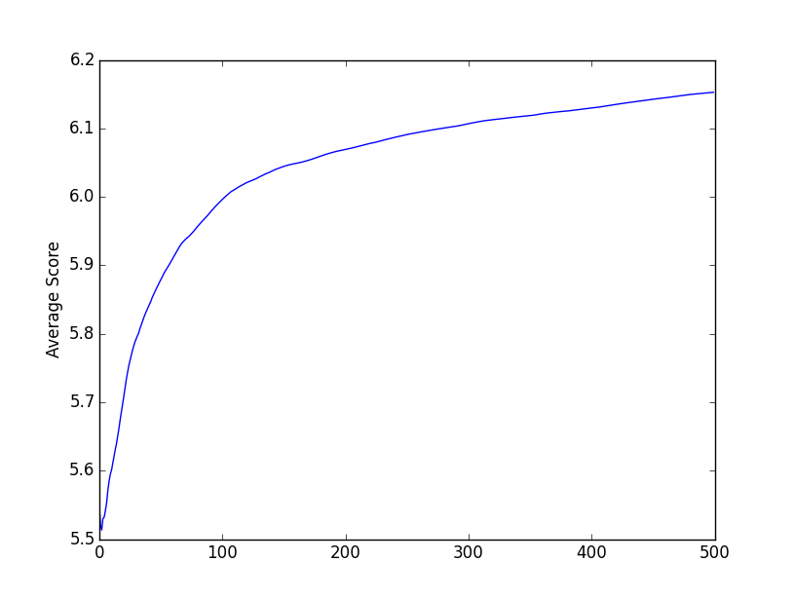
Training Results
Computer’s Crib
100 hands, 500 times
Opponents Crib
Optimal Average: 7.42
Optimal Average: 6.54

Slide 14
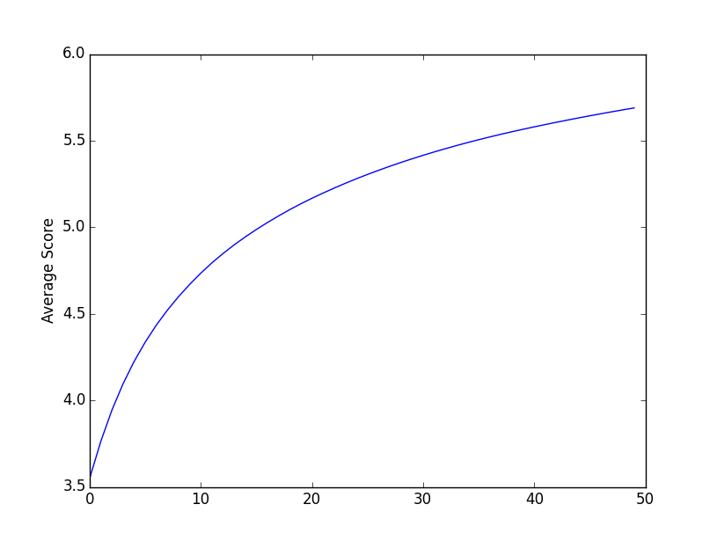
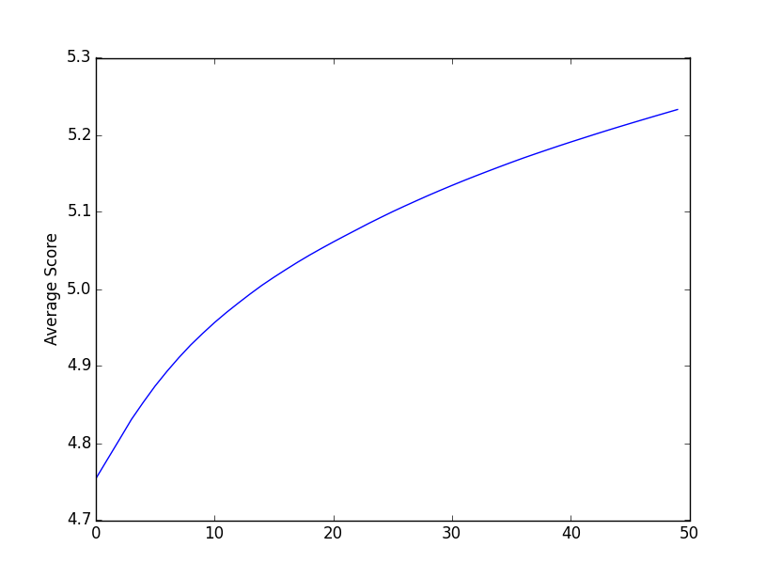
Training Results
Computer’s Crib
ALL hands, 50 times
Opponents Crib
Optimal Average: 7.38
Optimal Average: 6.49

Slide 15
Game Result
When a human plays against the computer, the computer does fairly poorly
This is to be expected because we only trained each hand 50 times
The average score for all the hands is roughly 2 points below the optimal average
Need to train longer, as is seen when we train 100 hands, 500 times

Slide 16
Future Work
Continue training each during game play
Extend the game to include Stage 2 of a round

Slide 17
References
Kendall, G. and Shaw, S. (2003) Investigation of an Adaptive Cribbage Player. LNCS 2883, pp. 29-41.

